Slide 1

Being Effective at Technical Communication
Technology Not Required
a.k.a. You Suck At Communicating (Thanks Ariel)
http://bit.ly/VMUG-BETC

Slide 2
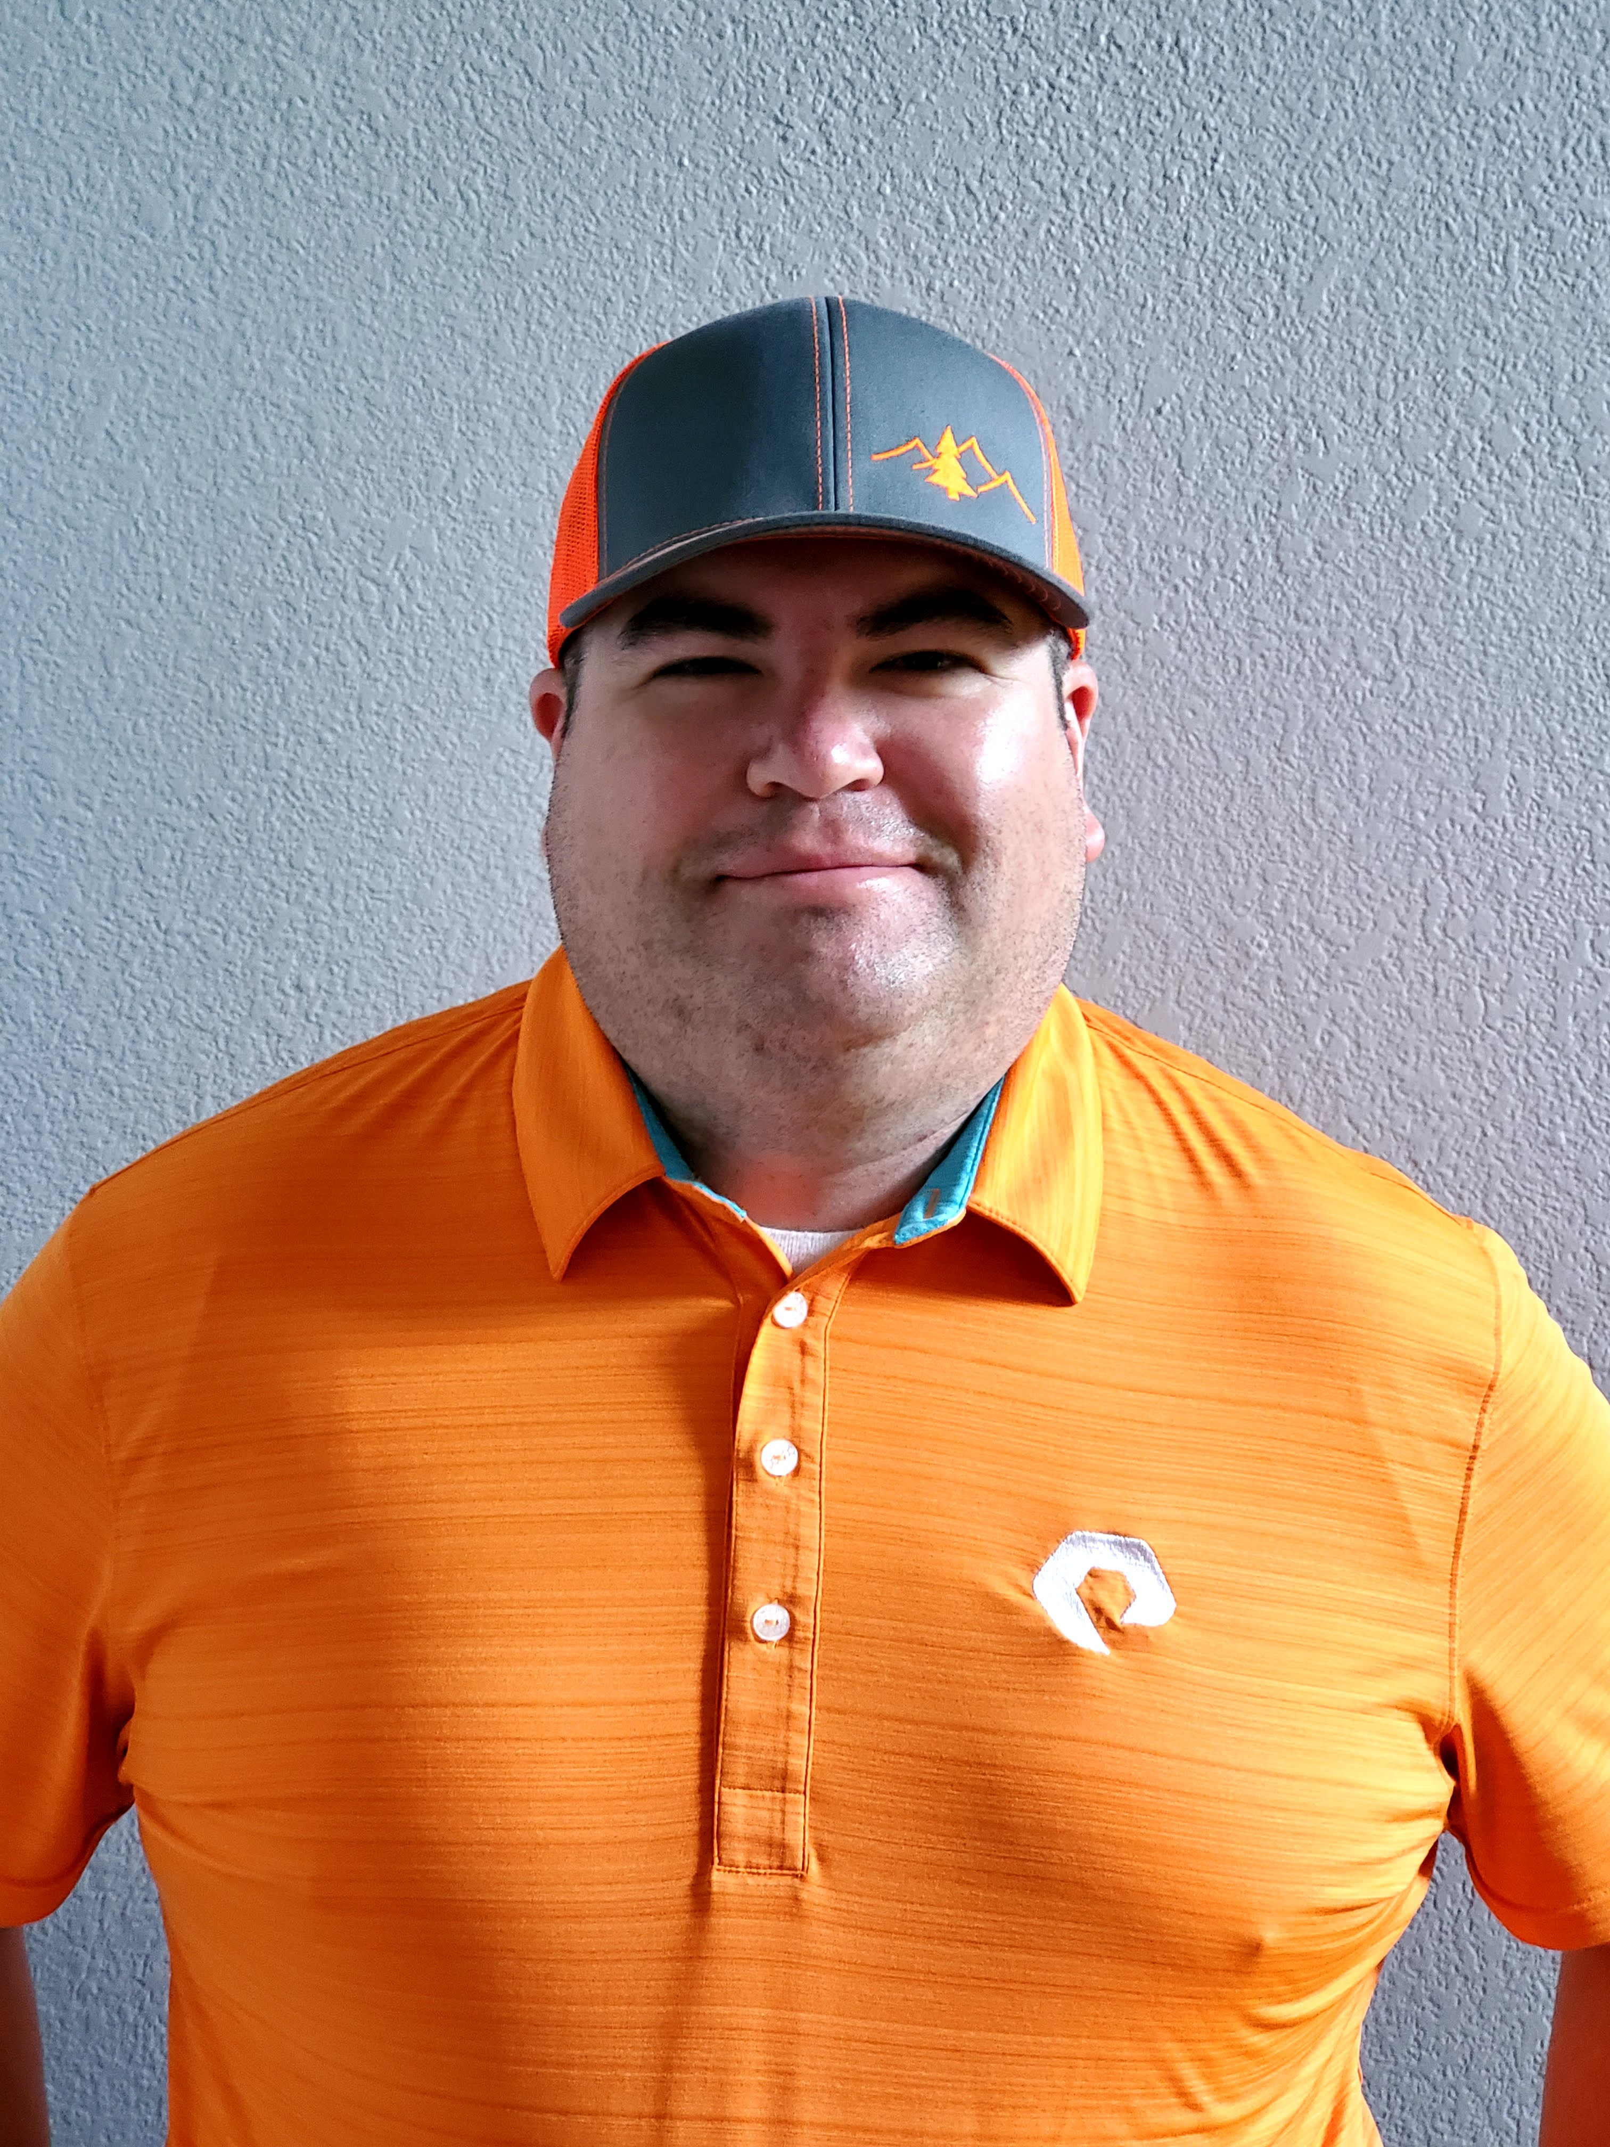
Howdy!
I’m Joe Houghes
I am here because I am a VMUG leader & I love to get people engaged and learning.
You can find me at @jhoughes or fullstackgeek.net
http://bit.ly/VMUG-BETC
Notes:
Co-leader - Austin VMUG & PowerShell User Group
Green hat, big grin and the loud "Howdy Y'all.“
Push yourself outside of your comfort zone
Learn more about any topic of interest
Stop letting fear keep you from sharing with others
Share your knowledge (Perspective is important)
Teach whatever you can (Be The Master)

Slide 3



About Me
Co-leader - Denver VMUG & PowerShell User Groups
Colored hat, big grin and the loud "Howdy Y'all.“
Push yourself
Learn more
Don’t fear sharing
Share YOUR knowledge (Perspective is important)
Teach whatever you can (Be The Master)

Slide 4

What are we here to talk about?
Definitions of communication/effective communications
Merriam-Webster
Google
Effective communications (by Joe)
What's the real point?
Getting the message across
Getting YOUR message across
Notes:
Merriam-Webster: “the act or process of using words, sounds, signs, or behaviors to express or exchange information or to express your ideas, thoughts, feelings, etc., to someone else.”
Google: “the imparting or exchanging of information by speaking, writing, or using some other medium” and “means of sending or receiving information, such as telephone lines/computers.”
Effective communications (by Joe): Ensuring that you & your audience are both understood, and feel that it was a successful exchange

Slide 5

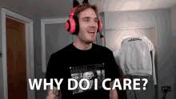
Why should you Care?
Critical to your relationships
Consider how you communicate with:
Spouse/partner/significant other
Children
Parents / Close Family
Co-workers – especially ones you may not be fond of
“Man on the Street”
Communications enable connections
Especially social connections
Don’t be A$$hole Joe

Slide 6
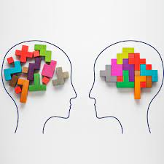
What are you bringing (unconsciously)?
Perceptions/Notions
What Prevents Effective Communication
Your emotions
Others’ emotions
Stress and other external influences
Lack of focus
Personality as Code
Change your defaults
Notes:
Perceptions/Notions
What Prevents Effective Communication
Your emotions
Others’ emotions
Stress and other external influences
Lack of focus
Personality as Code
Change your defaults

Slide 7

Know Your Audience
Look for background connections
Areas of common understanding
Smart person vs wise person
Don’t repeat mistakes without change
Peers are effective tools; you may need their support
Notes:
Smart people focus absorbing as much knowledge as possible and showing the world that they’re cleverer than average, whereas wise people also find knowledge within and aren’t so focussed on showing it off.
It's easier for a wise person to gain knowledge than for a smart person to gain judgment. The obvious difference is that being smart is a process of learning while being wise is a product of experience.
Smart person learns from their mistakes, wise person learns from the mistakes that others have already made.

Slide 8

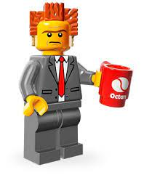
Learn You Some Business
Speak to your Audience in THEIR terms
Know your business
Is IT / technology really your business?
Technical Fellow of Cafeterias
PRO TIP:
Your job belongs to your employer. Your career belongs to YOU.
Notes:
HINT: It's your job, but it's probably not the business

Slide 9
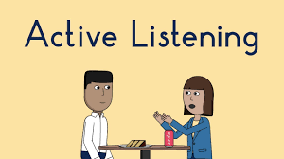
Actively Listen
Listen as much as you speak, if not more
Necessary for 2-way communication
2 Parts to the Message
Listen, Repeat, Get & Give Feedback
Make sure you are both understood
Notes:
2 Parts to the Message:
Sending the message
Receiving (and interpreting) the message
Make sure you are both understood
Ask open-ended questions to promote discussion & comprehension

Slide 10

Non-verbal Communications
Body language & engagement
Distractions
Notes:
Body language & engagement
Barrier for many people who are not comfortable with interpersonal communications
Key indicator of people being non-receptive, disinterested or lacking confidence
Eye contact, eye contact, eye contact!
Be relaxed, keep an open stance
Distractions
Laptops, phones, e-mail, chat – ask for people’s attention
Some distractions are external to your exchange
Not all distractions can be avoided or controlled

Slide 11
Visual Medium
Notes:
Delivery methods
Are you using the right medium?
Are you explaining your concept in simple or easy to follow terms? (Avoid acronym soup)
Are people in your audience visual or auditory learners?
Even for auditory learners, images can make abstract concepts easier to follow

Slide 12
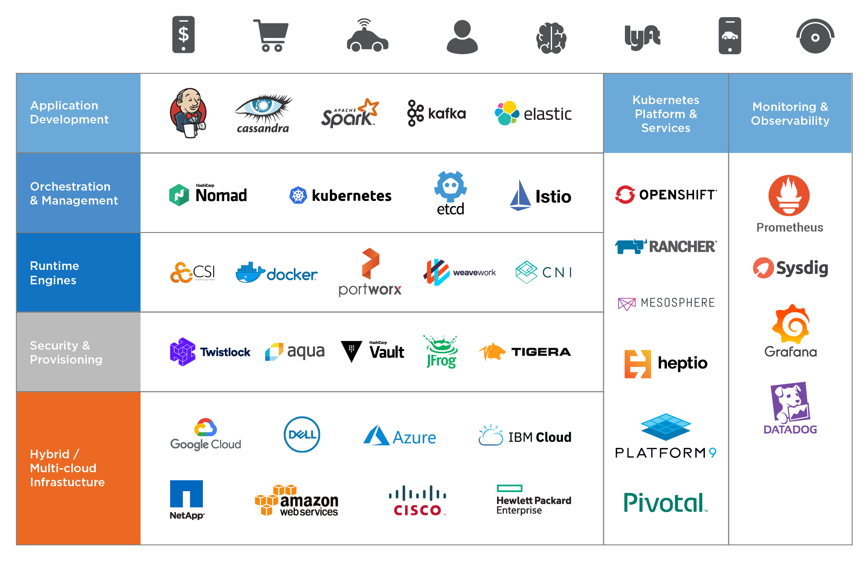
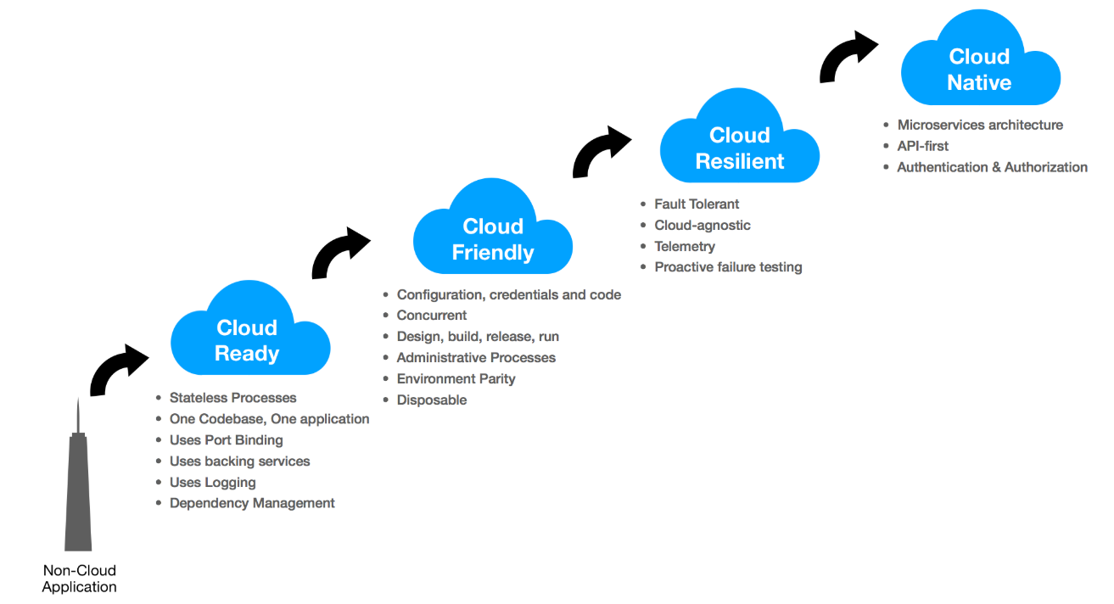
Visual(ly Appealing) Medium
PRO TIP: Be mindful of color blindness with slides or images (red/grn, bl/grn, bl/brn)
Notes:
Do this with your visual presentation:
Don’t start with the eye charts
Walk through your concept slowly
Periodically ensure that people are following with your walk through

Slide 13
Delivery method
PRO TIP: Be mindful of color blindness with slides or images (red/grn, bl/grn, bl/brn)

Slide 14
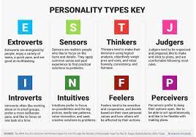
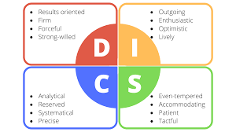
Personality Types
What are your motivations?
What are your goals?
What drives your interest?
Do you know what these answers are for people in your audience?
Emotions come into play, again
True Colors

Slide 15

Back It Up - My story from the near beginning
Boss was Yellow (fun focused), CIO was Gold (task focused)
How I discovered I was a Green (PURE technologist)
How that was publicly presented to me
The challenge after the training - Cut off from technology
How many seats on a boat?
Assigned Homework? It's a book report?!?!?!
Team Miracle

Slide 16
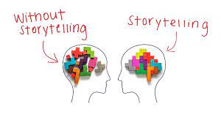
Tell a Story
Bring the audience with you
Make a personal connection
Draw in your audience (or pull them back in)

Slide 17
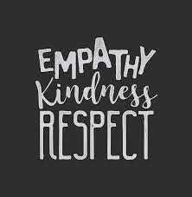
Respect & Empathy
Friendliness - Just Be Kind
We're all in this together
My #1 Rule - Apologies for being crude
Don't hold grudges

Slide 18

Open-Mindedness & Awareness
Be willing to change
Break out of your box
Encourage others to grow and change
The party is better when we're all invited

Slide 19

Confidence & Persuasiveness
Hearts & Minds
Not selling or tricking anyone
Let others reach their own conclusions and compare
Be Patient

Slide 20

Sound Bytes
Crucial Conversations - It's Not About Communication, it's About Results
Showing Our True Colors - Understand Your & Their Values, Needs, Strengths, Joys
Personality Lingo - Identifying your Personality; Breaking Out of a Box
Verbal Judo - The Gentle Art of Persuasion; What Not to Say
High Five! - None of Us Is As Smart As All Of Us
Soft Skills - Software developer's life manual

Slide 21

Do this for yourself
Greater personal success
Better relationships
Better organizational status
Less misunderstanding
Go fast versus go far

Slide 22
Book Recommendations
*Crucial Conversations (It's Not About Communication, I's About Results)
*Showing Our True Colors (Understand Your & Their Values, Needs, Strengths, Joys)
*Personality Lingo (Identifying your Personality - Breaking Out of a Box)
*Verbal Judo (The Gentle Art of Persuasion - What Not to Say)
*High Five! (None of Us Is As Smart As All Of Us)
*Soft Skills (Software developer's life manual)
How to Win Friends & Influence People
Presence: Bringing Your Boldest Self to Your Biggest Challenges
The Naked Presenter: Delivering Powerful Presentations With or Without Slides
The 17 Essential Qualities of a Team Player: Becoming the Kind of Person Every Team Wants
Great Work, Great Career
The Back of the Napkin (Expanded Edition): Solving Problems & Selling Ideas with Pictures
Switch: How to Change Things When Change Is Hard
Reclaiming Conversation: The Power of Talk in a Digital Age
The Secret Lives of Introverts: Inside Our Hidden World
Quiet: The Power of Introverts in a World That Can't Stop Talking
Never Split the Difference: Negotiating As If Your Life Depended On It
The No Asshole Rule: Building a Civilized Workplace and Surviving One That Isn't
Stress Less, Accomplish More: Meditation for Extraordinary Performance
Math with Bad Drawings: Illuminating the Ideas That Shape Our Reality
Ego Is the Enemy
Talk Like TED: The 9 Public-Speaking Secrets of the World's Top Minds
TED Talks: The Official TED Guide to Public Speaking
Management Focused (team leadership as well):
An Elegant Puzzle: Systems of Engineering Management
The Manager's Path: A Guide for Tech Leaders Navigating Growth and Change
The Ideal Team Player: How to Recognize and Cultivate The Three Essential Virtues
Unlearn: Let Go of Past Success to Achieve Extraordinary Results
Team Players and Teamwork: New Strategies for Developing Successful Collaboration
The Five Dysfunctions of a Team: A Leadership Fable

Slide 23
Thanks!
More Resources
http://bit.ly/VMUG-BETC
Any questions?
You can find me:
@jhoughes (Twitter)
& joe@fullstackgeek.net

